Slide 1
Michael Feuer’s Presentation
Inaugural
Richard Osborne Symposium
October 21, 2016
Cleveland, Ohio
©Max-Ventures LLC 2016.
10/18. Tue. 4PM

Slide 2
The Building of a Brand
What is a brand, how to create it and more importantly how to sustain and scale it.
Good brands never stop improving.

Slide 3


Let’s Play
“Name That Tune”
How many beats will it take you to name these…?

Slide 4
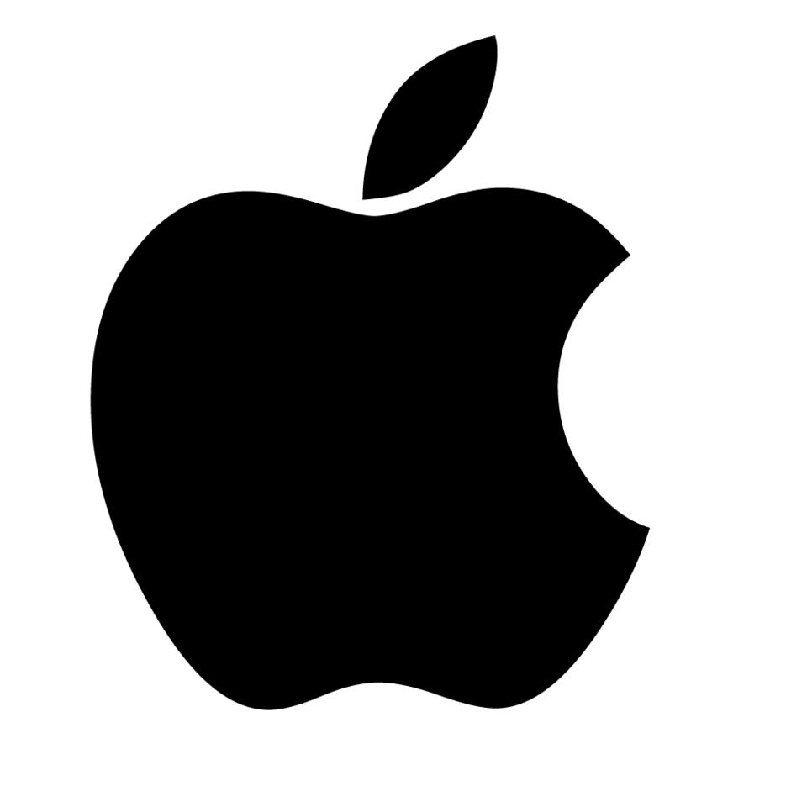
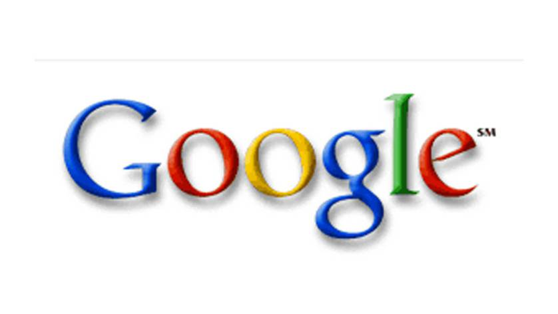

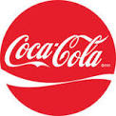
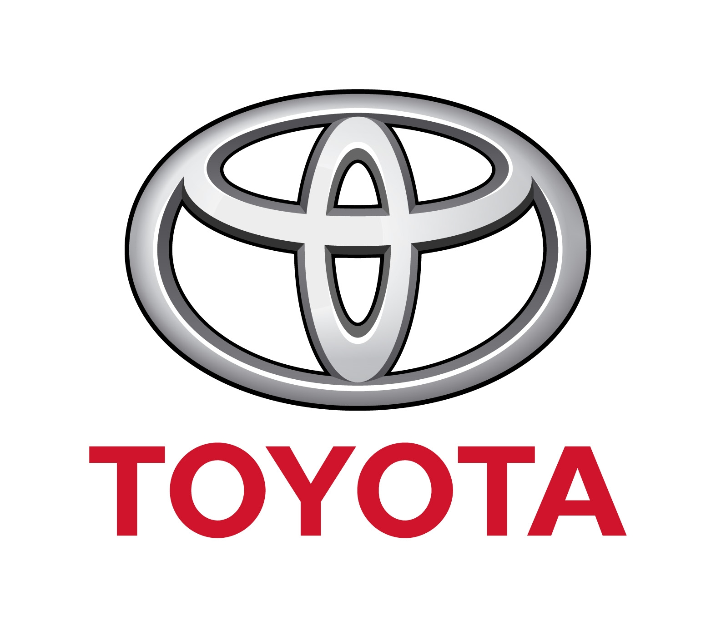


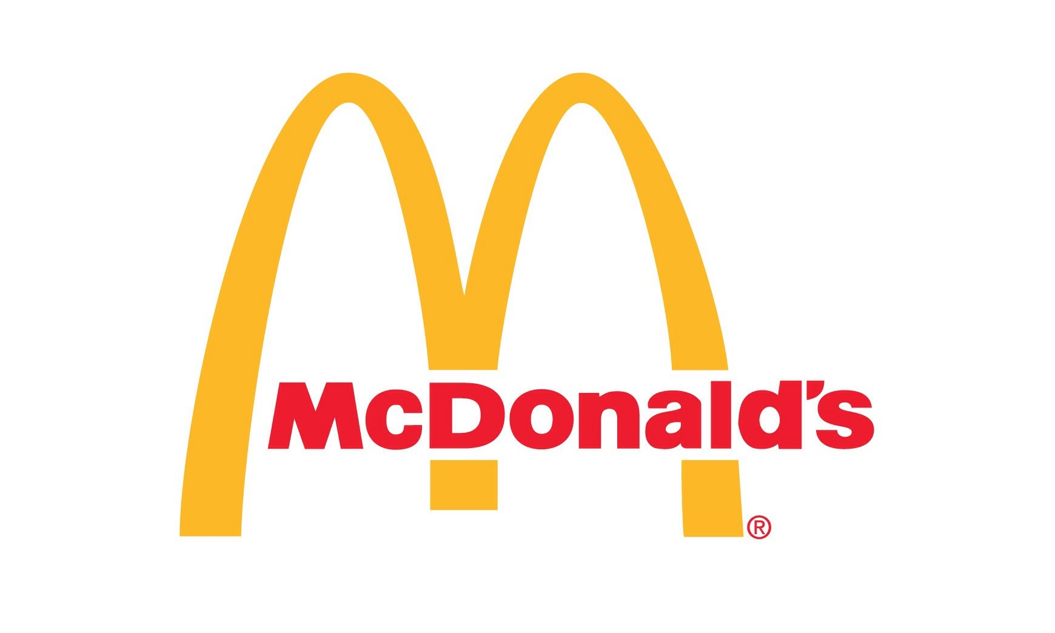

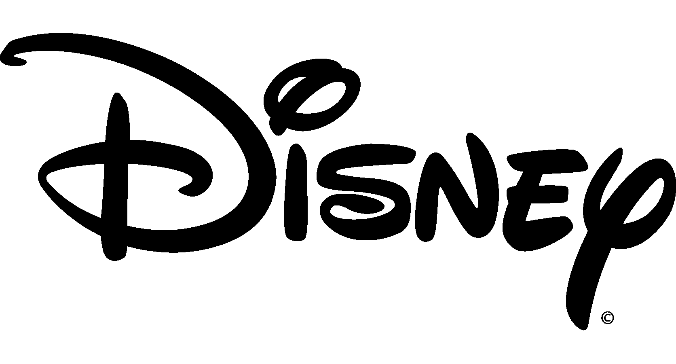
Top 10 US Brands & Estimated Value*
*Source: www.Forbes.com/Worlds Most Valuable Brands 2016/5.11.2016
$82.5 billion
$75.2 billion
$154.1 billion
$58.5 billion
$52.6 billion
$42.1 billion
$41.4 billion
$39.5 billion
$39.1 billion
$36.7 billion

Slide 5
Top 3 Brand Values as a % of Market Cap.*
McDonald’s 40% /$97B. Started 1961 – 55 yrs.
Coke 32%/$180B. Started 1896 - 120 yrs.
Disney 28%/$146B. Started 1923 - 93 yrs.
Youngest company/Lowest ratio: Alphabet/Google 15%/$547B. Started 2004 – 12 yrs.
*As of Oct. 14.2016

Slide 6
What Helps Drive Brand Value?
Age matters. Value increases with time
and exposure.
Multi-media Advertising (including social media) is a new key driver.
Having a fun/catchy jingle doesn’t hurt.

Slide 7
We’re talking serious money?
Top 10 brands have combined
value of $621.7 billion
A wide range:
#1 Apple: $154.1 billion
#10 GE: $36.7 billion

Slide 8
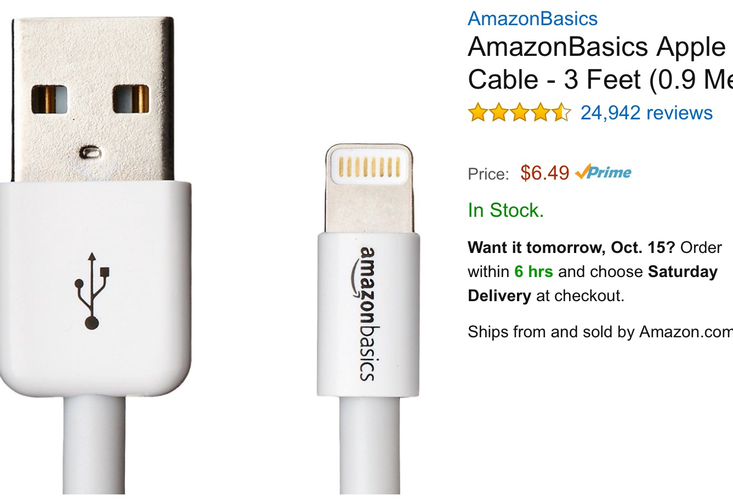
Brand math made simple an actual example:
Apple brand Lighting Cord
Retail $19.00 – cost $2.00=$17.00 margin/gross margin 89.5%
Certified non-branded lighting cord
Retail $6.49 – cost $2.00=$4.49 margin/gross margin 69.2%
Same item/same purpose: Brand vs non- brand generic.

Slide 9
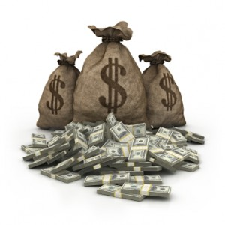
What makes a brand successful
Two prime ingredients:
1. PROMISES MADE.
2. PROMISES KEPT.

Slide 10
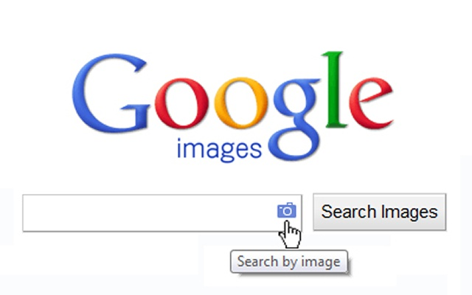
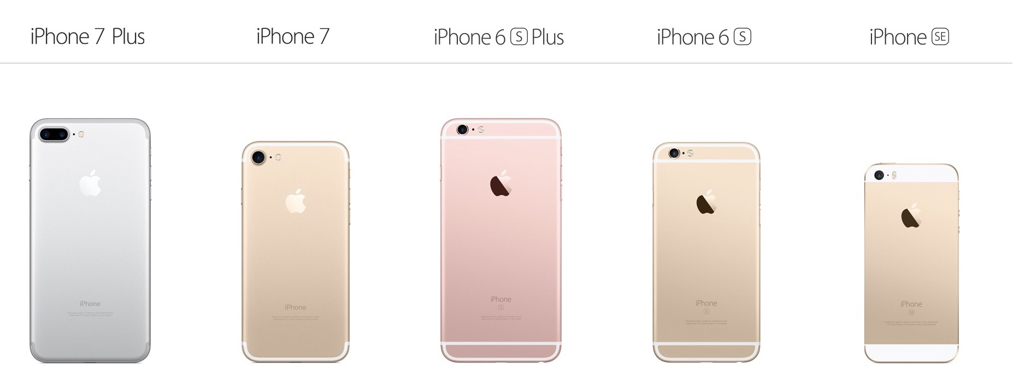
The genesis of building a brand
Start with an idea.
Ask: Does product or service provide something the end-user wants or needs?
The best brands may begin with something the customer may not even know is needed.

Slide 11
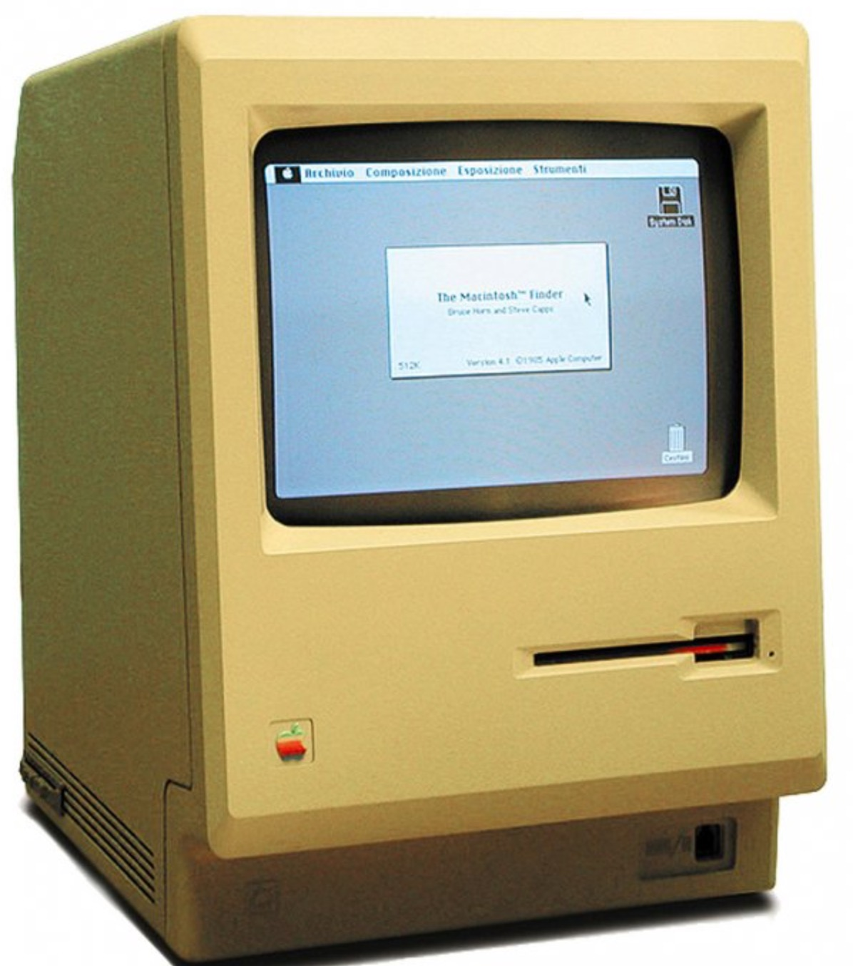
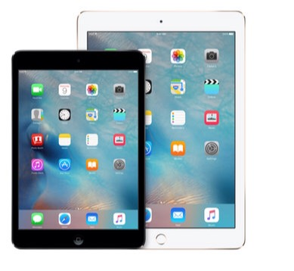
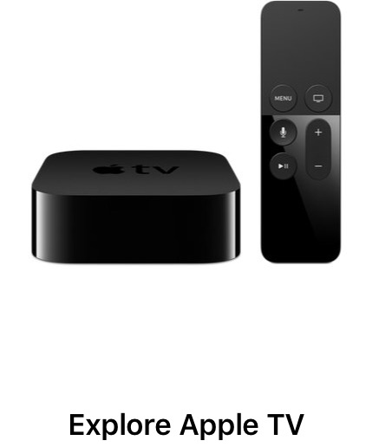
The promise must be sustainable & scalable
Can’t build a brand with a here today, gone tomorrow promise.
Once the brand keeps the promise, make it better.
Apple computers started with a clunky desktop.
Today the iPhone 7 is more powerful in 6.63 oz. than computer on Apollo 11 moon mission.
Apple scaled its products to include: iPhone, iPads, iPods, iTunes, Apple TV, and much more.

Slide 12
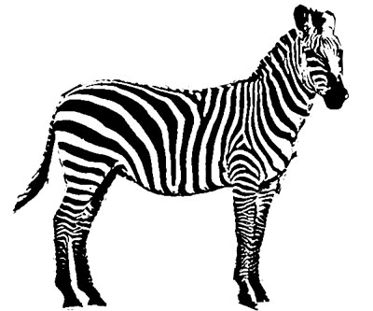
Paranoia is a secret sauce in continuously improving a brand
A brand that looks over its shoulder improves.
Just be sure when you hear hoof beats you look for horses not zebras.
A good brand innovates & disrupts.
Failures are an important part of sustainability.
Constantly search for brand extensions that enhance the promise and open new markets.

Slide 13


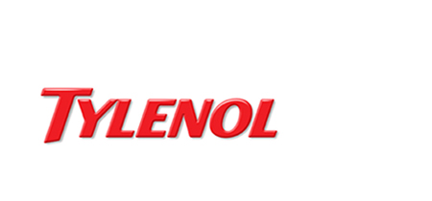
Protecting a brand integrity is job #1
A brand’s most valuable asset is its reputation.
– – well not so much today.
Doing it right:
The 1982 brand crisis.

Slide 14
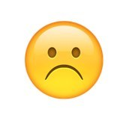

Unhappy customer must always win --even when wrong
If brand falls short, must fix as measured in hours or days - not weeks or months.
Customers complaining are looking for a reason to continue to do business with the brand.
Biggest danger is brand fails and the customer remains silent, voting with wallet/feet.

Slide 15

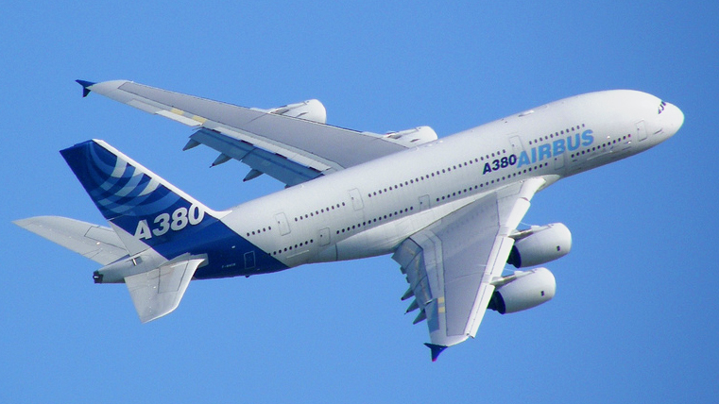
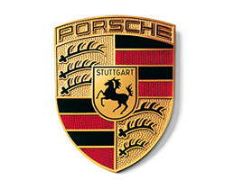
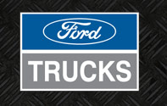

Brands that flirt in the dark aren’t flirting – – no one sees
What’s in it for the customer.
Delivering the promise makes satisfied customers brand advocates -- biggest promoters.
Create an aura of belonging for customers.
Airline mileage programs, car owners such as:

Slide 16
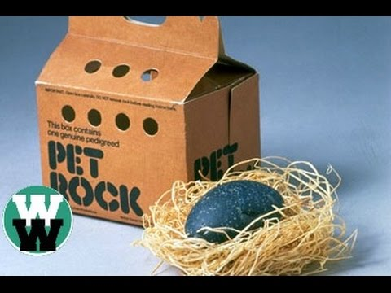
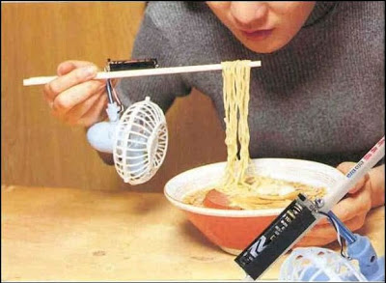
Brands you never heard of and why
Didn’t make a viable promise or broke it.
Never created a reason to exist, i.e. what’s in it for the user.
Wasn’t explained correctly.
Attention, Interest, Desire, Action – – without evoking these will never get off the ground.

Slide 17
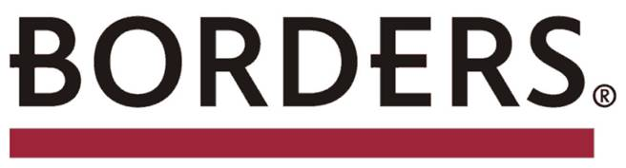
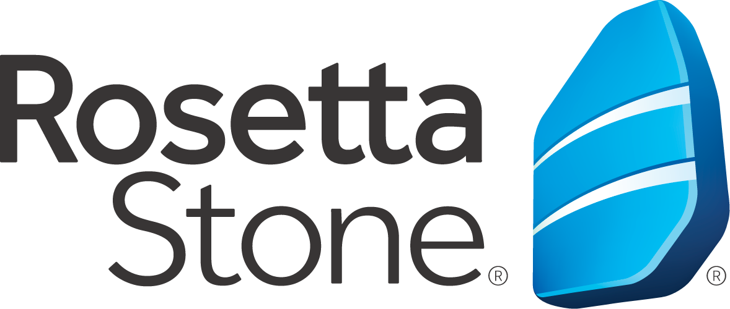



Brands that started strong and fizzled-Why?
– no e-reader such as the Barnes & Noble Nook -- -had Amazon run Borders website. Amazon converted Borders customers to its own.
– founded language learning using CD – ROM and didn’t see web learning and the Internet coming.
– – lived in a world of brick and mortar ---didn’t realize customers are time- stressed, time-pressed. These brands needed the customer more than the customers needed them.

Slide 18
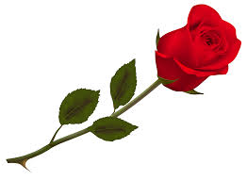



A rose is a rose by any name …brand names that initially meant nothing
– four meaningless letters that became the brand for I-EEE-802.11, which didn’t quite
            roll off the tongue.
– - wasn’t a name but made-up to epitomize quality. Sounded/looked so awkward that it had to be authentic.
– a weird name that meant nothing until Google began flirting with customers. Sounded so strange it became catchy quickly.

Slide 19
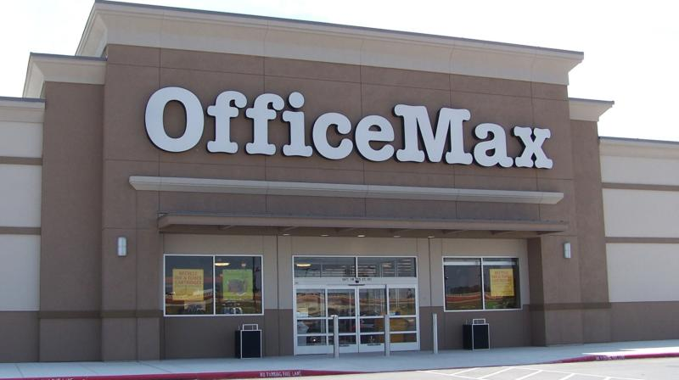
My own case study – –
OfficeMax (OMX)
Started with $20 thousand of my own money, a partner and a few investors. Mostly doctors and lawyers. Why?
Opened first store in 1988 Cle. (Mayfield Hts.) grew to 1100 stores throughout the US and internationally with revenues of $5 billion.

Slide 20
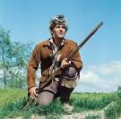
…….OfficeMax story
Pioneers are many times found face down in the mud – – with arrows in their backs.
OMX was number 19 to start in new industry of 20 companies.
Built the brand by positioning against what the others were doing wrong.

Slide 21
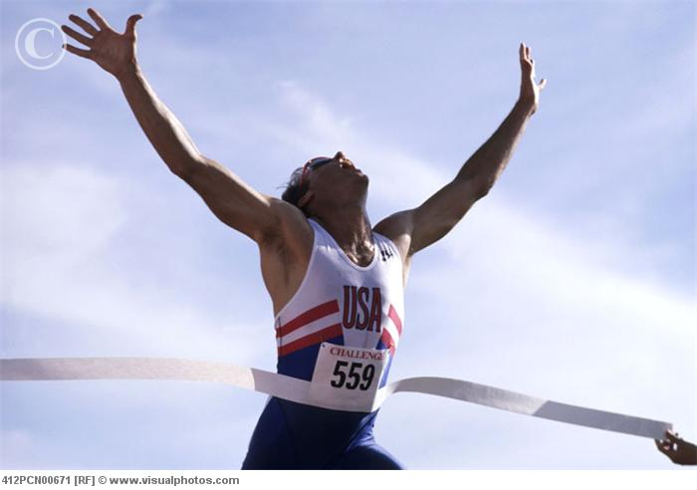
OMX early winning strategy
First two years stayed out of the way of competition. Not enough money to fight.
Began with a whisper and built to a shout.
Kept promise of selection, service, price & product knowledge.
Located stores to intercept customers – – corner of Main and Main
Opened next to a competitor, if possible.

Slide 22
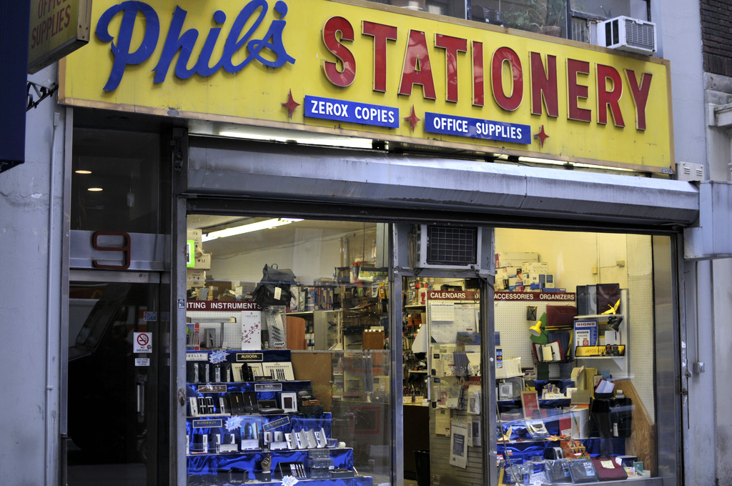
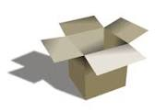
Positioned OMX against competitors
Traditional office stores opened when owners wanted to do business, 9 to 5 syndrome, not not when customers wanted to shop.
Eliminated price as a determinant – by guaranteeing the lowest price.
Traditional retailers sold everything in a plain brown box.
OMX took everything out of the box, brought product to life - encouraged prospective buyers to touch/feel to experience what
  the product did.

Slide 23
Positioning OfficeMax
Trained Associates to explain attributes of every product.
OMX return policy was: didn’t have one. Customer was always right even if wrong.
In 16 years, over 10 iterations of prototype store – –
Created scalable offerings – – brand extensions: FurnitureMax, CopyMax, TechMax, BatteryMax commercial sales, catalog, internet.

Slide 24
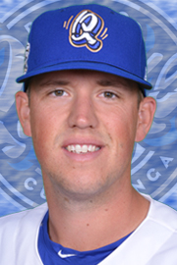
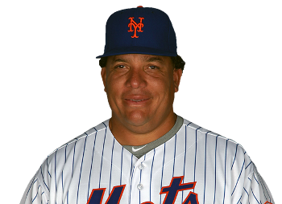
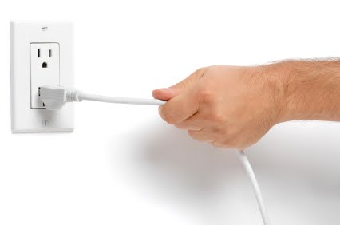
Who were the undercover OfficeMax Reps: Bartolo Colon, Orel Hershiser?
Listened to customers to improve the brand, but had to be a good detective/translator, understand what customers really meant.
When something wasn’t working pulled the plug and started over.
Experiment – – don’t have to hit a home run every time at bat.

Slide 25
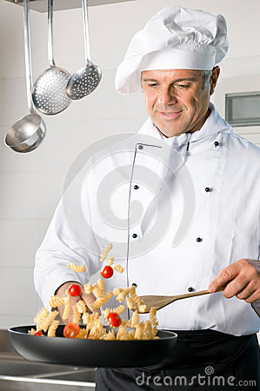
Business Plan vs.
Being Opportunistic
The ingredients that made OMX 1 of 5 companies to reach revenue of $3 billion in first 8 yrs. of starting?*
*Companies that began before 2005

Slide 26
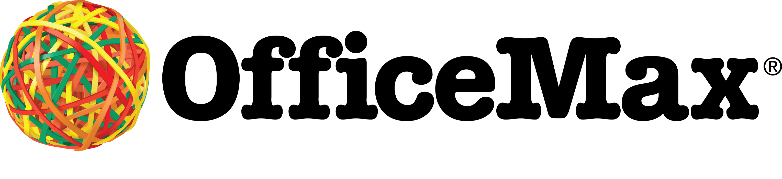
OfficeMax
Made big promises!!

Slide 27
Kept every promise or stopped making the promise
if couldn’t deliver.

Slide 28
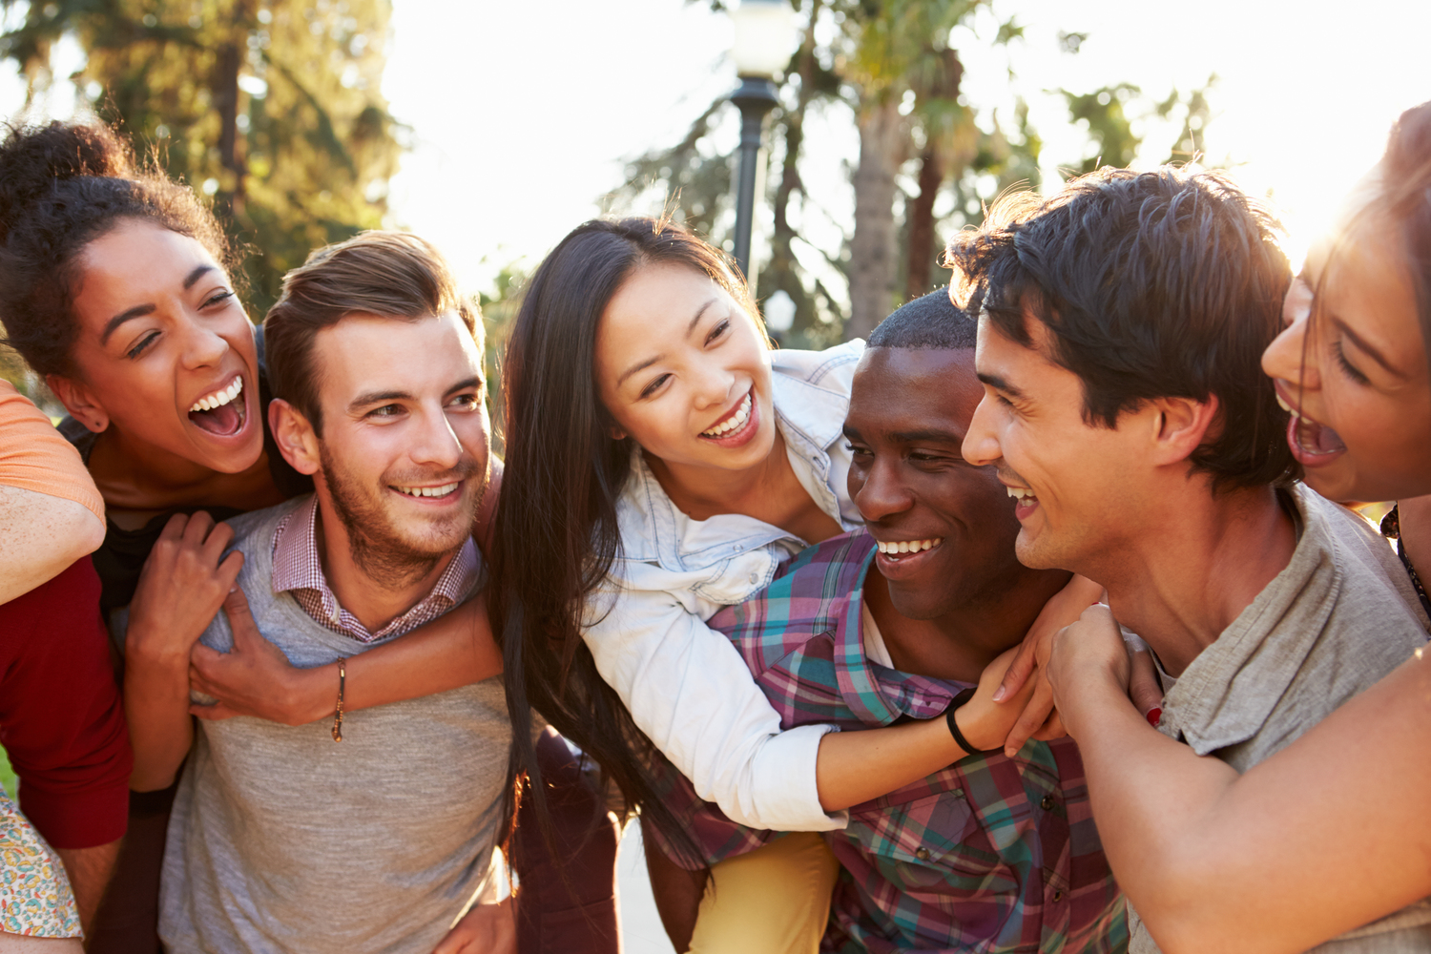
Created an internal, unique brand-aka Culture
Relentless pursuit of innovating – – a team that never quit.
“Come from behind kids” – – relished being the underdog – – surprised on the upside.
Employees minimal experience, but very smart, unrelenting could go further faster.
A company that could laugh at itself, have fun, but didn’t suffer fools.

Slide 29
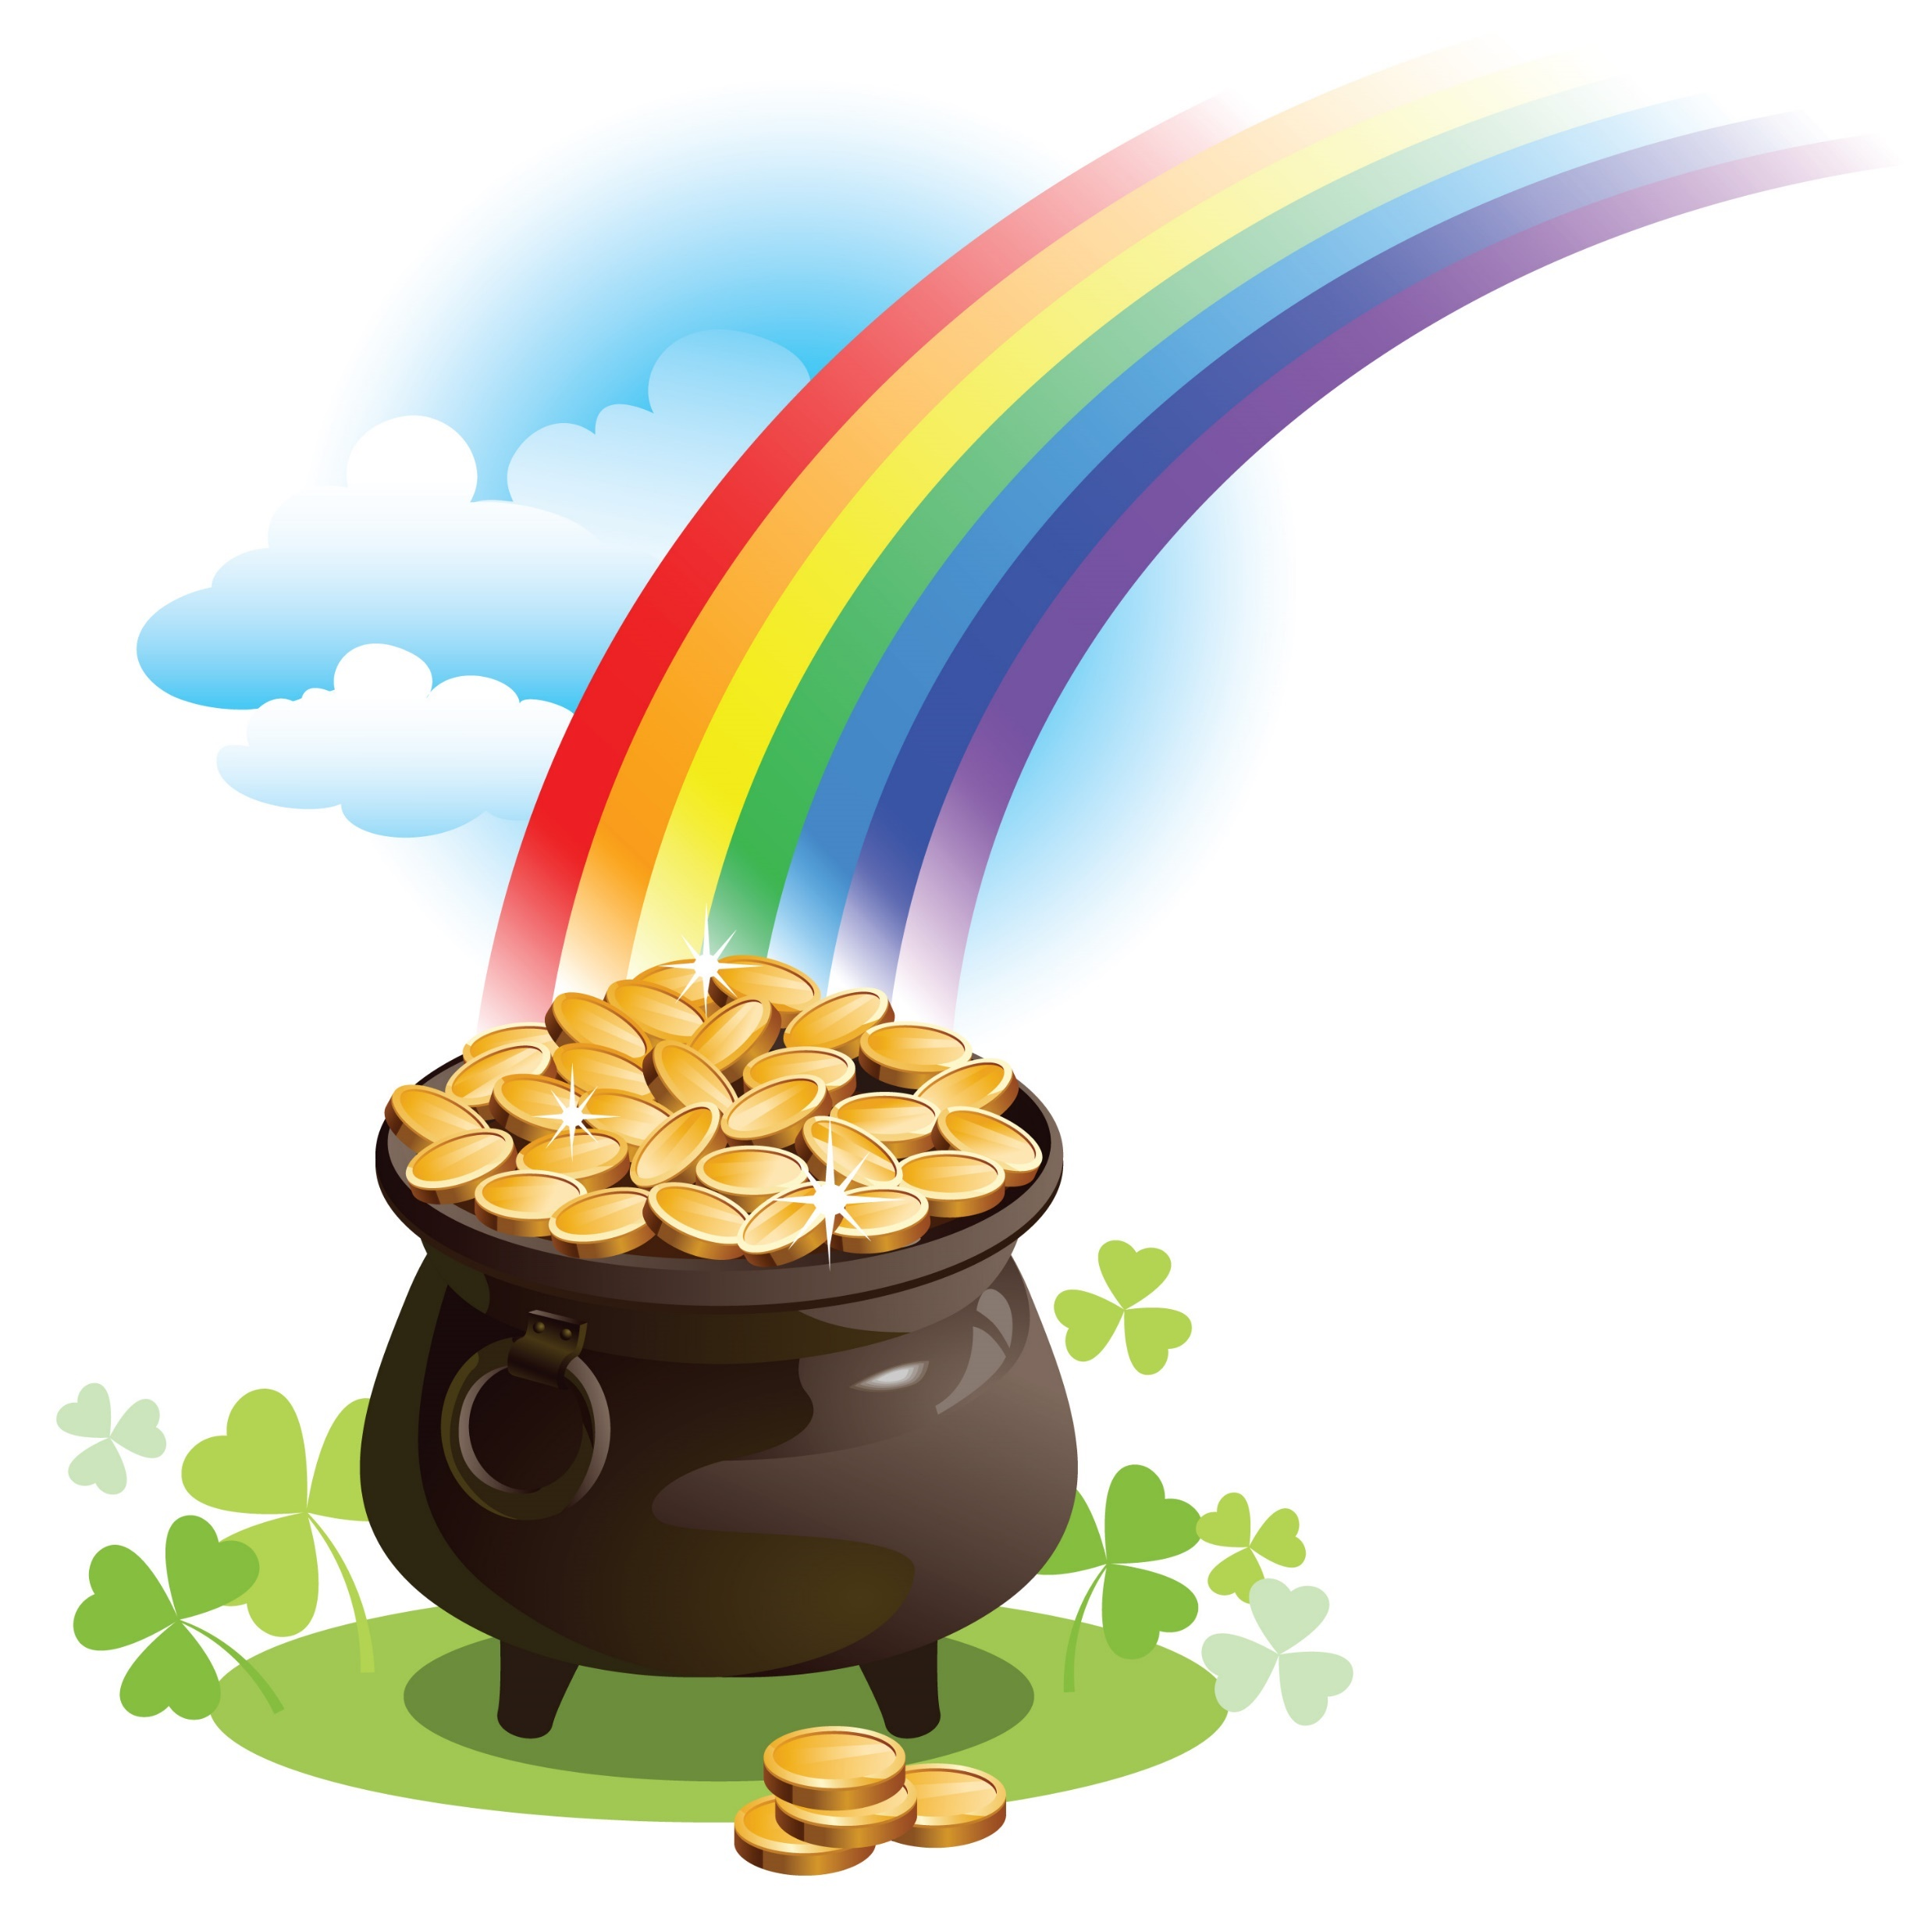
Skin in the game and a pot of gold at the end of the rainbow
Every employee in management including 1100 store management teams had a piece of the action.
Provided payoffs along the way but no free rides.

Slide 30
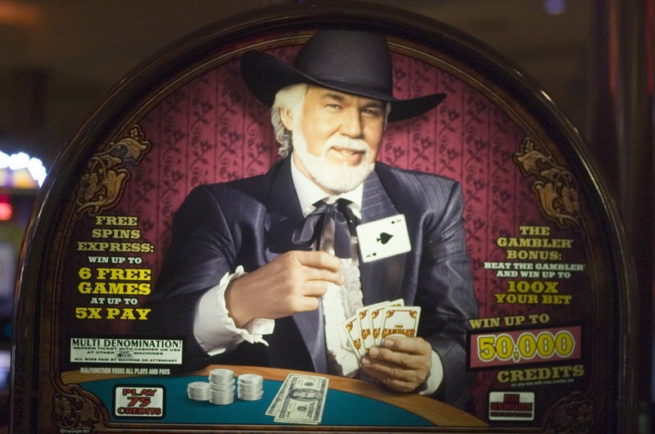
OMX LIF0– – Know when to hold ‘em, when to fold ‘em
Sold OMX for $5 billion after 16 years.
Created many millionaires, educations for children, enabled associates to buy dream homes, more comfortable retirement.
“Stories about OMX like
fine wine improved with age?”

Slide 31
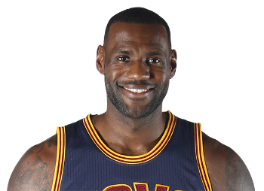
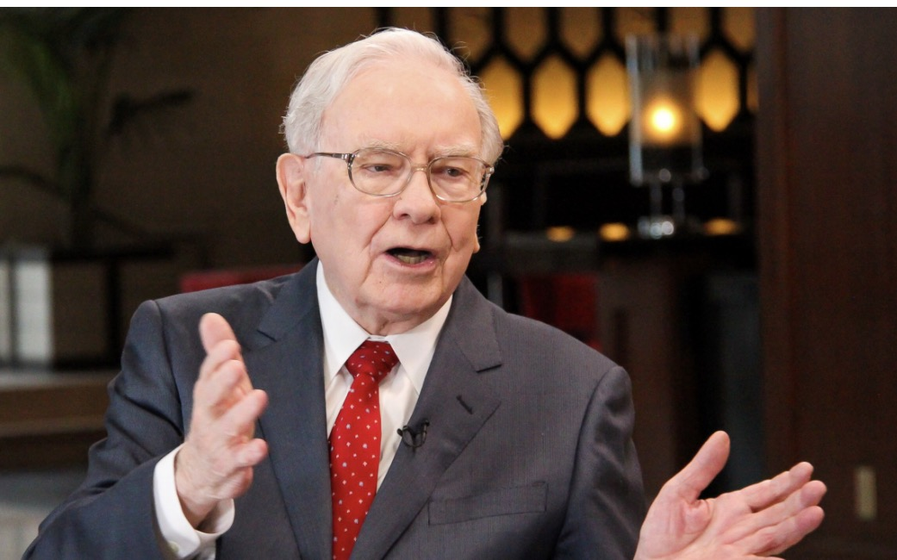
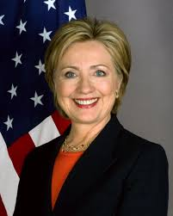
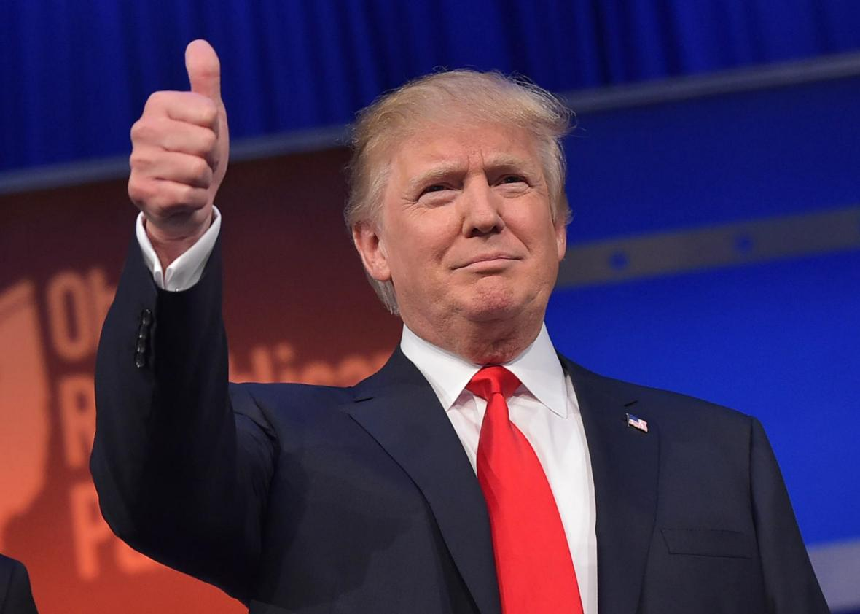
People can be brands, too
LeBron James (nothing but net)
Warren Buffett (nothing but money)
Hillary Clinton, Donald Trump (nothing but ?..…you decide)

Slide 32
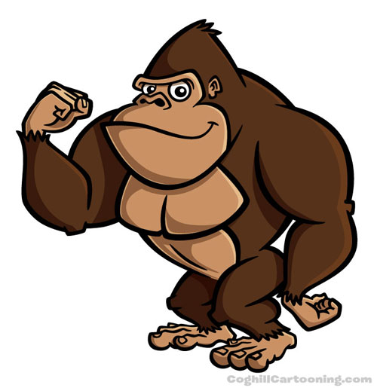
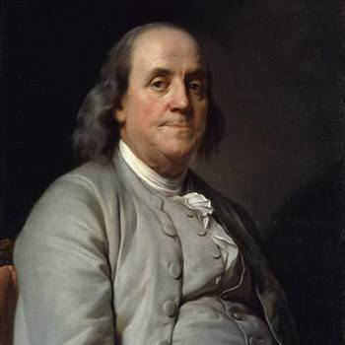
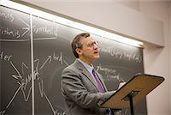
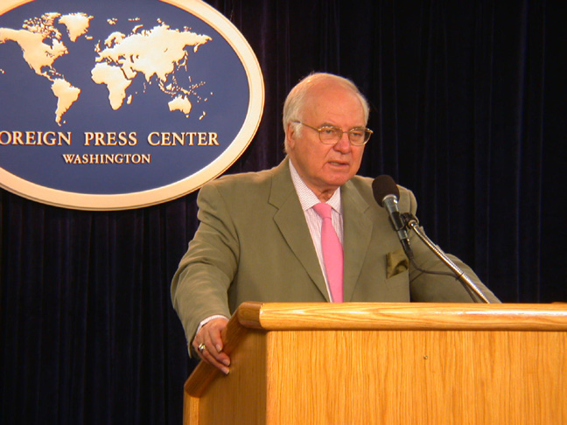
The Real Deal….
Gorilla
Innovator
Educator
Communicator

Slide 33
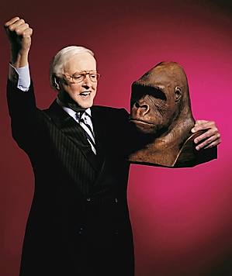
Not only a giant among men
He’s a BRAND!
Prof. Richard L. Osborne
Makes Promises
Keeps Promises

Slide 34
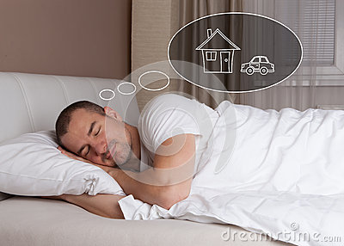
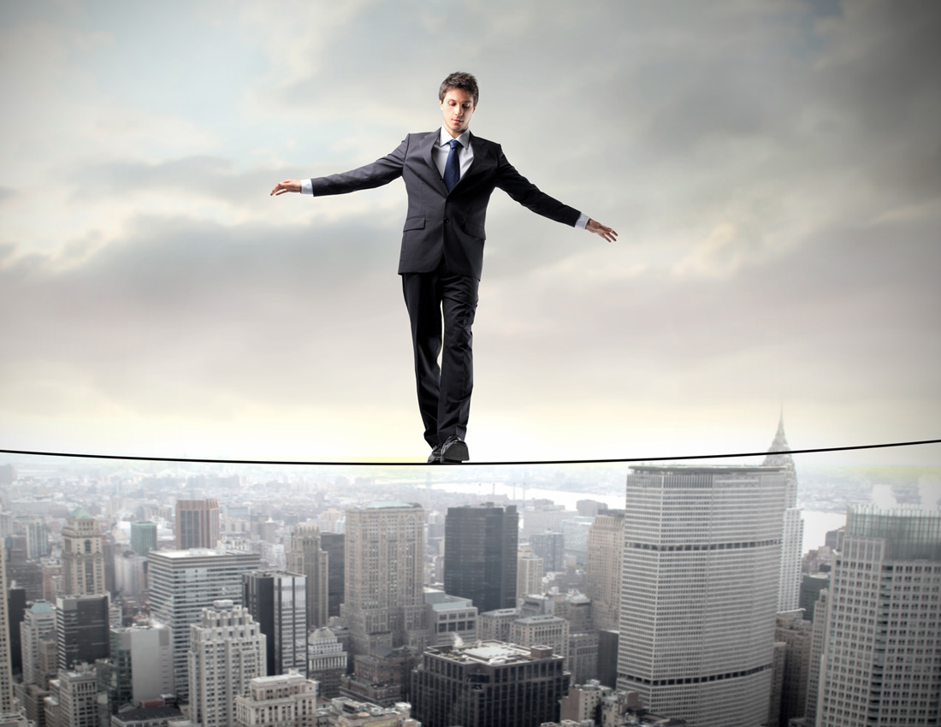
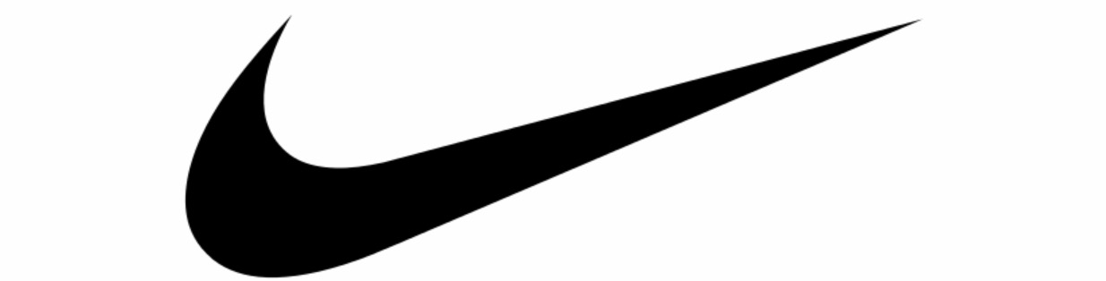
Thank You. Q&A next…
Not the end, just the beginning
Dream, Dare, Do!

Slide 35
2 must-read books. Order from Amazon.com
0r go to: www.tipsfromthetop.info
Email free_columns@mfeuer.com SmartBusiness
include your email in subject
Michael’s Free monthly SmartBusiness column. Email:free_columns@mfeuer.com
In subject line include your email address.

